Slide 1
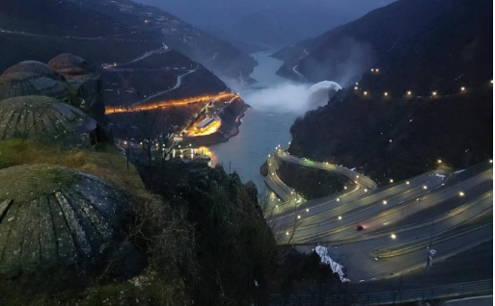
Challenges and opportunities for dams and reservoirs in the 21st century
Michel LINO
President of ICOLD

Slide 2
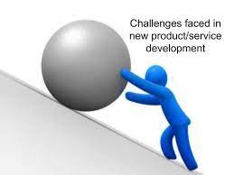
Major challenges
Dam safety
New hazard related to climate change
Sustainability
Public acceptance
New opportunities
Energy transition
Mitigation and adaptation to the climate crisis

Slide 3
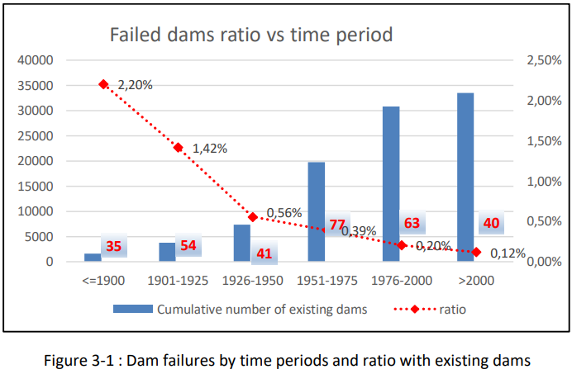
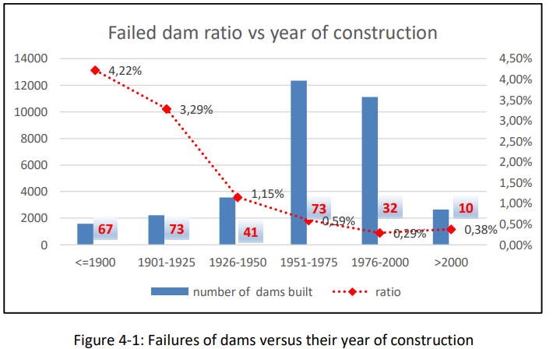
Dam safety
Dam safety is ICOLD's highest value.
Since the beginning of its history, almost a century ago, improving the safety of dams has been ICOLD's main mission. Great success has been achieved and the failure rate of dams has decreased dramatically throughout the 20th century.
However, since the beginning of the 21st century, this trend seems to be in question, as evidenced by the recrudescence of dam failures observed worldwide.
ICOLD Bulletin 188

Slide 4
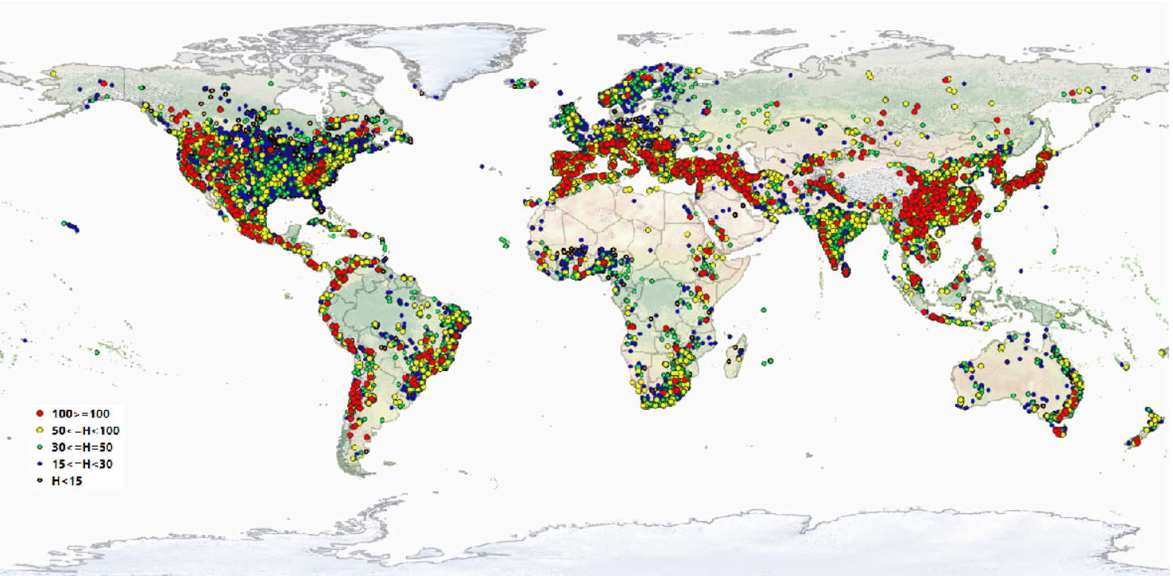
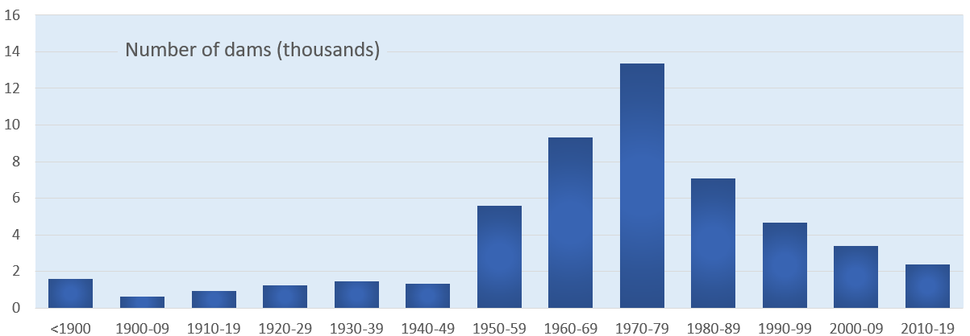
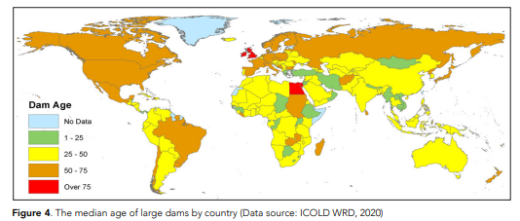
Dam safety: an ageing portfolio of dams
UNU report 2021 : very negative view on the World dam portfolio
It is critical to maintain our 60.000 existing dams.
If properly maintained and safely operated, the lifetime of dams can be centuries.
Maintenance includes periodic safety review (5-10 years) and adequate financial resources.
Efficient water management, maintenance, rehabilitation, reengineering of existing facilities to meet the future use.
Sedimentation management must be improved

Slide 5
Dam safety: climate change create new hazards
Human activities, principally through emissions of GHG, have caused global warming, with global surface temperature increase reaching 1.2°C.
The range of future temperature increase is large and depends on our actions to reduce GHG emissions.
Human influence has increased the frequency and intensity of extreme events, heatwaves, droughts and floods.
Recrudescence of incidents or failure in flood condition in the last decade
ICOLD Q107 – General Report – 2022 - figure and data from IPCC (2021)

Slide 6
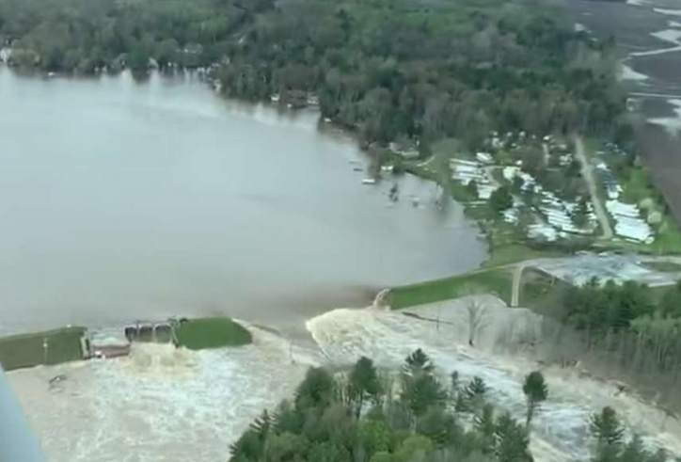
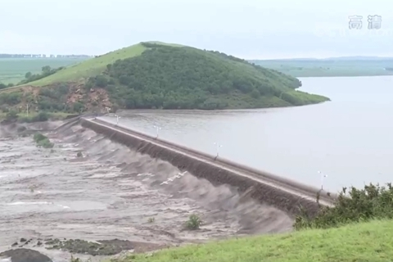
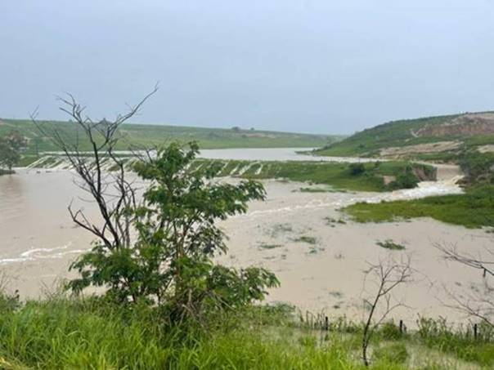
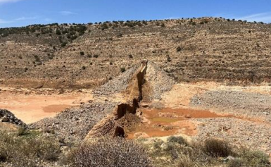
Dam safety: Many failures during flood in the last decade
Recrudescence of failure during flood
Xinfa dam (China) failure by overtopping (July 2021)
Chungthang CFRD dam – India (October 2023)
Edenville dam – USA (May 2020)
Igua dam – Brazil (Dec. 2021)
Abu Mansour dam (Libya) (Sept. 2023)
14 de Julho dam– Rio Grande do Sur (May. 2024)
Bu Mansour dam (Libya) -(Sept 2023)
Notes:
All of them are embankment dams, highlly vulneravle to overtopping, except the dam in Rio Grande do Sur which is a lean RCC gravity dam.

Slide 7
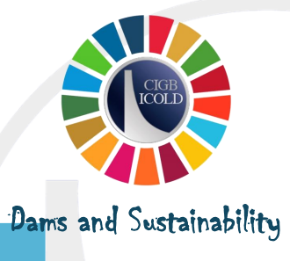
Sustainability : We have to implement sustainable dams
Reduction of carbon footprint of dam construction
Concrete dams have a high carbon footprint
ICOLD launched an initiative to promote dam sustainability
New approaches for sedimentation control
Sluicing and flushing sediments
Sediment diversion tunnel
Basin management approach
New type of dams with reduced E&S impacts
off-river dams with pumped or gravity-fed reservoir
dams at sea,
dam raising…
Preservation/ improvement of the biodiversity
Ensuring the biological continuity of rivers (fish ladder…)
Decommissioning of dams that are no longer useful
Maintaining (or providing…) ecological flow during dry period and drought

Slide 8
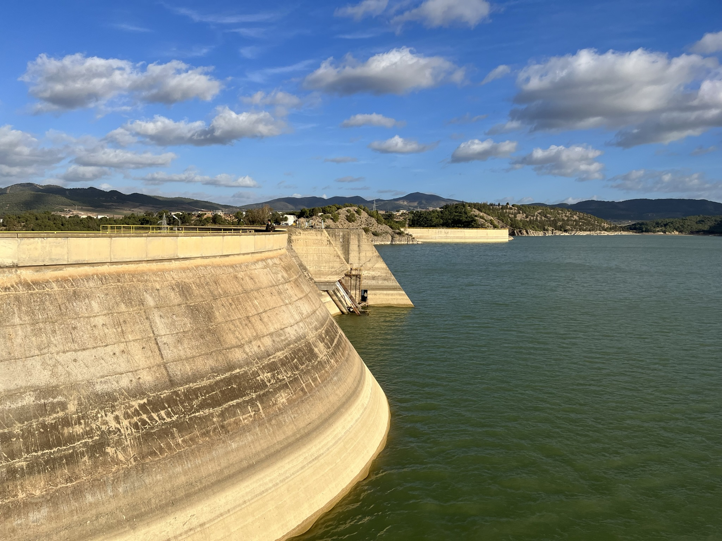
More reservoirs are needed for water management in a warmer world
Climate change adaptation
water management
Watersheds with significant reservoir capacity of regulation are more resilient to water resource changes and less vulnerable to climate change, with storage acting as a buffer against climate change.
Annual/seasonal regulation: Excess water from the rainy season is released during the dry season when needed for crop growth in irrigated agriculture.
Interannual regulation : large flood are stored and released during the following dry period.
Water supply for irrigation: 40% of the total food production .
Water supply for communities (including mega cities).
Mitigation of more severe and more frequent droughts.
Flood protection: big reservoir to store the flood or smaller flood control dam.
Water transfers to deal with uneven geographic distribution of water.

Slide 9
Climate change adaptation
Dams for energy transition
The use of low-emission or zero-emission renewable clean energy to replace traditional fossil energy is a critical measure to slow down the impact of global climate change in the future.
Hydropower today is 50% of the world renewable energy production.
Almost100% of electricity generation by 2050 should come from non-fossil sources to meet the goals of the Paris Agreement (<1,5°).
IEA 2022 report : we must double the hydropower capacity by 2050 , ie x3 the 2000-2025 rate.
Solar and wind are the two main sources of renewable energy at very low cost but they are intermittent.
Hydropower and Pumped Storage Plant are essential to integrate intermittent renewables.
Energy and emissions trends in the Net‐Zero Emissions Scenario (IEA 2021)

Slide 10
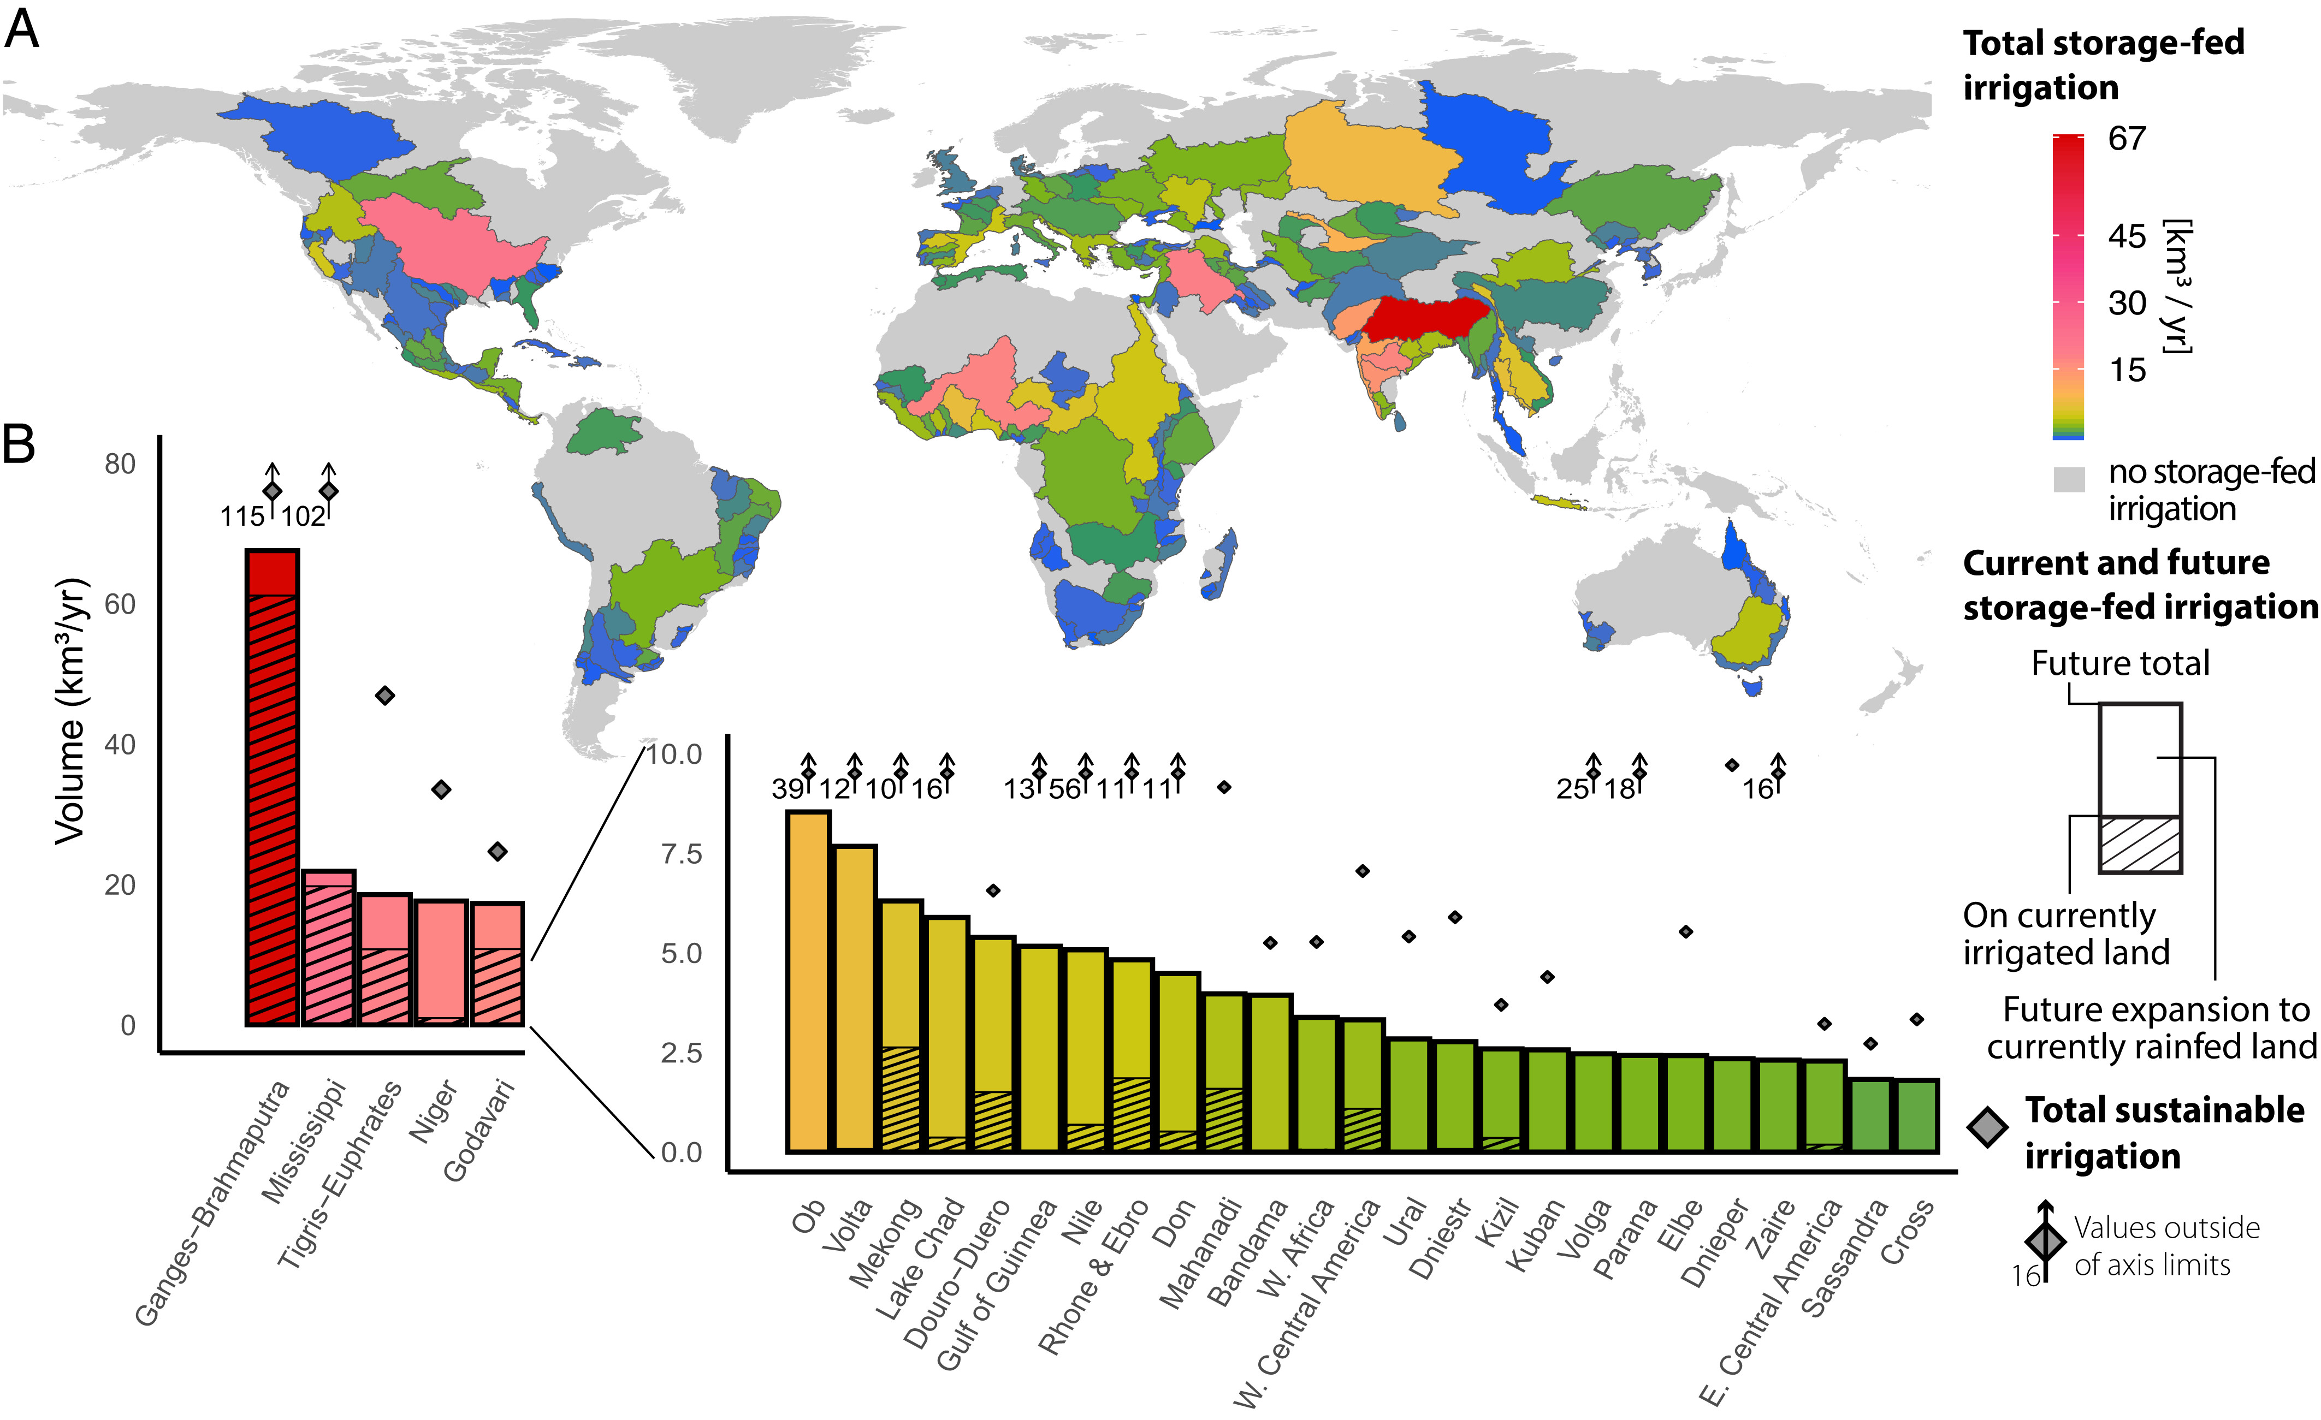
Climate Change adaptation:
Food production
By 2050, food demand is projected to increase significantly as the population grows and welfare demands increase.
World irrigated agriculture: 70% of total water use and 40% total food production on 20% total cultivated land.
Future irrigation will require 460 km³/yr of water from temporary storage (storage-fed irrigation), 58% on currently irrigated land, and additional 42% when expanding irrigation onto rainfed lands (*).
Sustainable water resources sufficient to feed additional 1.2 billion people can only be used if water storage is provided. So current and future reservoirs will be crucial for food security.
Potentials for storage-fed irrigation on a basin scale, accounting for storage-fed irrigation on currently irrigated and rainfed croplands.
Breakdown of basin-scale totals into storage-fed irrigation on currently irrigated land (hatched bar area) and on currently rainfed croplands to which irrigation could be extended in the future (nonhatched bar).
Source : “Global expansion of sustainable irrigation limited by water storage” ; Rafael J. P. Schmitt and al. – Stanford University – October 2022

Slide 11
Gaining Public Acceptance
More reservoirs are needed, but project development is very long and hazardous
The public is largely not in favor of dams.
But Climate crisis changes the game.
Advocates for the dam can be heard again
We must improve:
E&S impacts assessment and mitigation,
Fair share of the benefits among stakeholders
Fair comparison between the solutions
Improved communication with the public, the media and the decision makers.

Slide 12
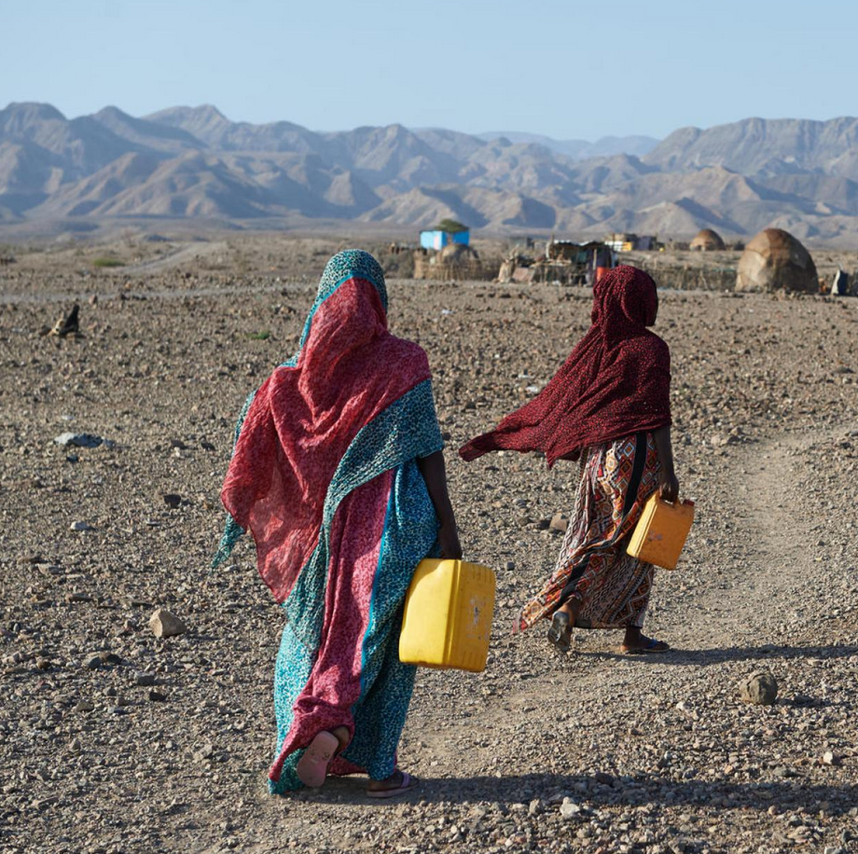
More water storage for a warmer world
Sustainable and safe dams for a better future

